Slide 1
Blood Bank Management System
Frontend: HTML, CSS, Bootstrap, React · Backend: Java + Spring Boot ·
Database: MySQL
Extras: JWT auth · REST APIs · Google Maps · Cloud Storage

Slide 2

The Problem
Blood must be found fast — not searched manually.
Delay = Risk
Manual calls waste critical minutes
Fragmented Data
Donor records, inventory, and locations scattered
Need for automation
Fast matching + verified eligibility

Slide 3


Core Workflow
Request
Match
Verify
Track
Request blood → Smart match donors/stock → Medical verification → Track bag to recipient

Slide 4
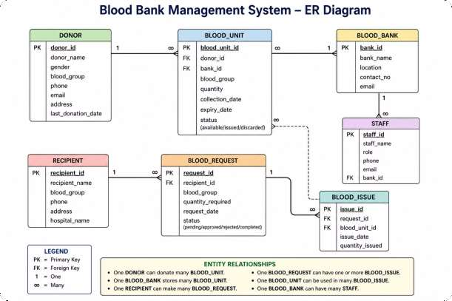

Slide 5
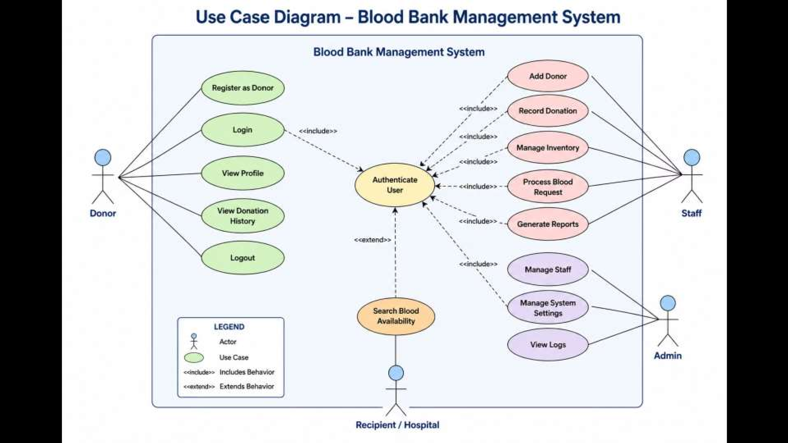

Slide 6
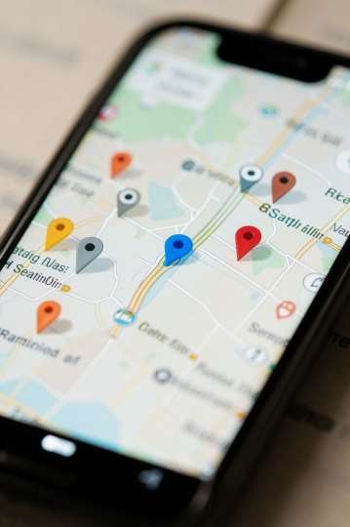
Location-based Matching
Google Maps API: lat/long proximity search · Nearby donor & blood center suggestions
Emergency Mode
Closest matches prioritized
Route & ETA
Show fastest route for donor or courier

Slide 7
Security: JWT Authentication
Stateless tokens for React → Spring Boot APIs
Role-based Access
Admin, Doctor, Donor scopes enforced
Secure Endpoints
Token refresh, expiry, and revocation flows

Slide 8


REST APIs & Data
Modules: donors ·
blood · stock ·
requests · reports
CRUD endpoints
(Spring Boot)
Validation & business rules (server side)
MySQL for persistent, transactional data
React Request
Spring Boot
MySQL
Persist

Slide 9


Cloud Storage & Media
Store certificates, consent forms, donor photos
Keep React UI lightweight — serve assets from cloud
Secure Uploads
Fast Fetch
Signed URLs · Access
controls
CDN-backed delivery

Slide 10

Conclusion — Time Saved = Lives
Saved
Stack recap: HTML/CSS/Bootstrap/React · Java Spring Boot · MySQL ·
JWT · REST · Google Maps · Cloud Storage
Demo Flow
Urgent request → Map match → Secure update → Inventory
confirm
Next Steps
Live demo, user testing, deployment

